Slide 1
Regression
RX 319
Introduction to Healthcare Analytics

Slide 2
Learning Objectives
Describe linear regression.
Interpret the results of a linear regression analysis.
Compare and contrast linear regression with logistic regression.
2

Slide 3
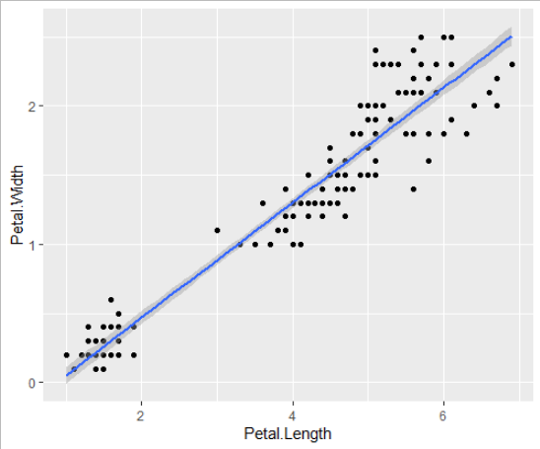
Linear Regression
Provides a slope, intercept
P-values suggest whether parameters are significantly different from zero
> regression <- lm(Petal.Width ~ Petal.Length, data = iris)
y = -0.36 + 0.42x
> summary(regression)
Coefficients:
Estimate Std. Error t value Pr(>|t|)
(Intercept) -0.363076 0.039762 -9.131 4.7e-16 ***
Petal.Length 0.415755 0.009582 43.387 < 2e-16 ***
3

Slide 4
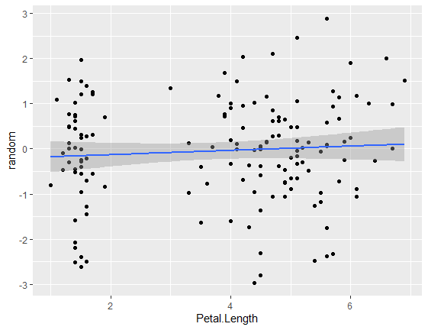
Linear Regression
Provides a slope, intercept
P-values suggest whether parameters are significantly different from zero
Coefficients:
Estimate Std. Error t value Pr(>|t|)
(Intercept) -0.22833 0.21992 -1.038 0.301
Petal.Length 0.04767 0.05300 0.899 0.370
4

Slide 5
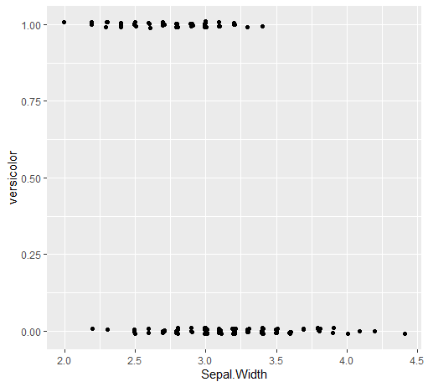
Logistic Regression
Similar, but now we’re predicting 0/1
“yes” or “no”, for example
> regression <- glm(versicolor ~ Sepal.Width, data = iris, family = "binomial")
> summary(regression)
Coefficients:
Estimate Std. Error z value Pr(>|z|)
(Intercept) 8.8908 1.8719 4.750 2.04e-06 ***
Sepal.Width -3.2223 0.6372 -5.057 4.25e-07 ***

